Slide 1
Distributed Forces
Dr. Jacob Moore
Associate Professor of Engineering
Penn State Mont Alto

Slide 2
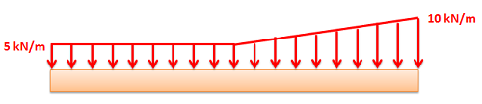
Distributed Forces
A distributed force is any force where the point of application is spread out over an area or a volume.
Distributed forces are represented by a field of vectors.
The force still has:
A magnitude
A direction
A “point” of application

Slide 3


Distributed Forces
Distributed forces can further be broken down into surface forces and body forces.
A surface force is distributed over a surface
A body force is distributed over a volume.

Slide 4
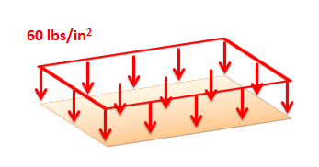
Surface Forces
A surface force is a force distributed over an area.
Along a single dimension
Along a 2D surface
Units for the magnitude will be given in unit force per distance, or unit force per distance squared.
A surface force, particularly a 2D surface force, can also be called a pressure.

Slide 5
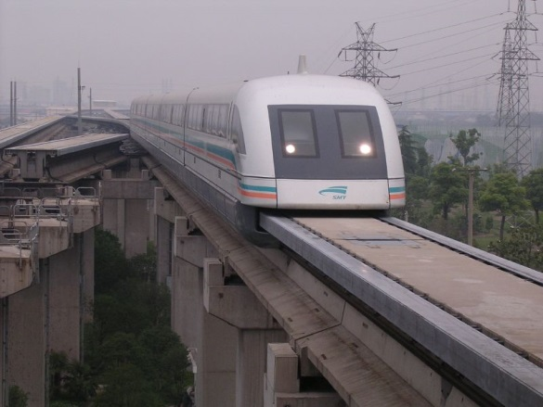
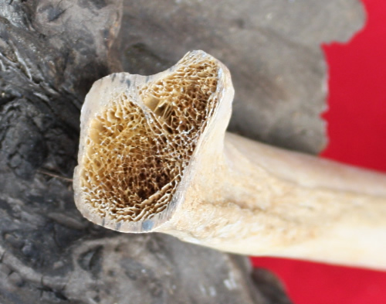
Body Forces
A body force is a force distributed over a volume.
They are not usually drawn in as a field of vectors because the diagrams would become overwhelming.
Units for the magnitude will be given in unit force per distance cubed.
A gravitational body force can be thought of as the weight due to object density.

Slide 6
Distributed Forces and The Equivalent Point Load
Distributed forces are difficult to deal with directly in the equilibrium equations or equations of motion.
Because of this, we usually convert the distributed force into it’s equivalent point load.
This is a point force that will cause the same accelerations, or the same reaction forces as the original distributed force.
More details on this process on the equivalent point load page.

Slide 7
Thanks for Watching
See other engineering mechanics videos and access the full tool at…

